Slide 1
Intro to NGS Bioinformatics using Tufts HPC
Rebecca Batorsky
Sr Bioinformatics Specialist
May 2020
Notes:
Notes on programming language - prereqs

Slide 2
Requirements
HPC Cluster Account available to Tufts affiliates
VPN if working off campus
Basic knowledge of Linux and HPC:
Intro to Linux
HPC Quick Start guide or Intro to HPC
We’ll test out access together during this session.
Depending on the number/type of questions, we may choose to follow up after the session.
Notes:
Notes on programming language - prereqs

Slide 3
Course Format
1-hour Zoom Introduction
~3 hours of self-guided material on github, suggested to be completed over the next week: https://rbatorsky.github.io/intro-to-ngs-bioinformatics/
(working with a partner is encouraged)
Piazza
Please ask and answer questions liberally on Piazza
Steps to enroll in class if you are not auto-enrolled:
https://piazza.com/tufts
1: Intro to NGS Bioinformatics
Join as student
If you can’t access Piazza for some reason please let me know Rebecca.Batorsky@tufts.edu
Notes:
Notes on programming language - prereqs

Slide 4
Bioinformatics goals
Variant Calling and Interpretation for a human exome sample
Intro to several common bioinformatics tools: BWA, Samtools, Picard, GATK, IGV
Writing and running bash scripts
Using modules on the HPC
Notes:
Notes on programming language - prereqs

Slide 5
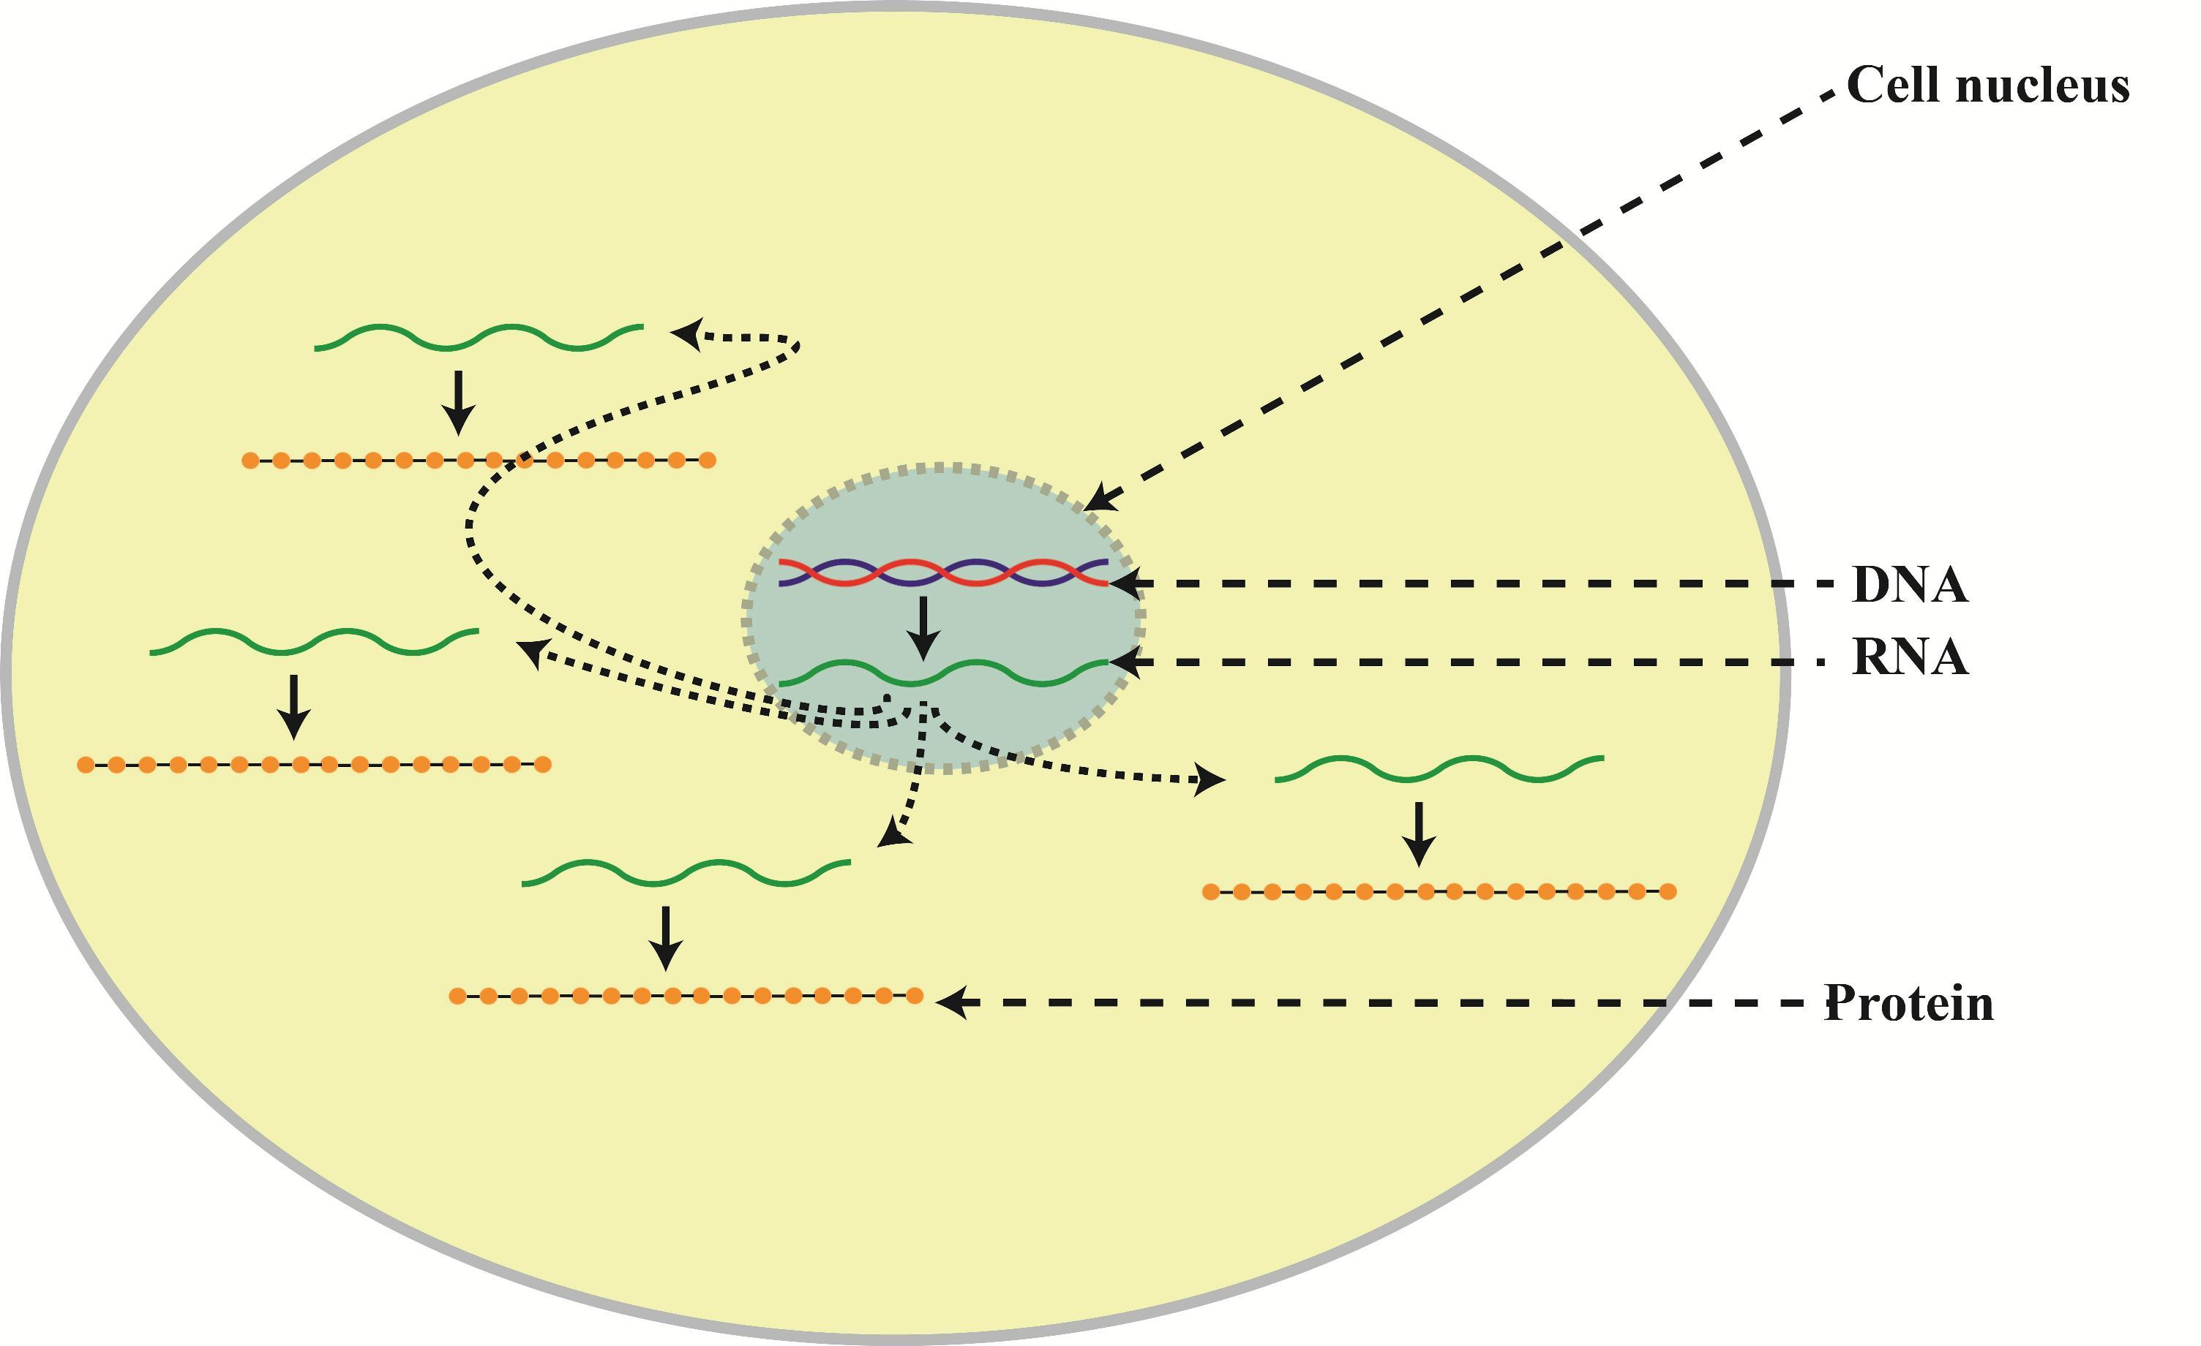
DNA and RNA in a cell
https://i0.wp.com/science-explained.com/wp-content/uploads/2013/08/Cell.jpg

Slide 6
Two common analysis goals
DNA Sequencing
RNA Sequencing
Fixed copy of a gene per cell
Analysis goal:
Variant calling and interpretation
Copy of a transcript per cell depends on gene expression
Analysis goal: Differential expression and interpretation
https://i0.wp.com/science-explained.com/wp-content/uploads/2013/08/Cell.jpg

Slide 7
This workshop will cover DNA sequencing
Not today!
Check out our 6/2/20 workshop:
https://tufts.libcal.com/event/6716203
DNA Sequencing
RNA Sequencing
Fixed copy of a gene per cell
Analysis goal:
Variant calling and interpretation
Copy of a gene per cell depends on gene expression
Analysis goal: Differential expression and interpretation
https://i0.wp.com/science-explained.com/wp-content/uploads/2013/08/Cell.jpg

Slide 8
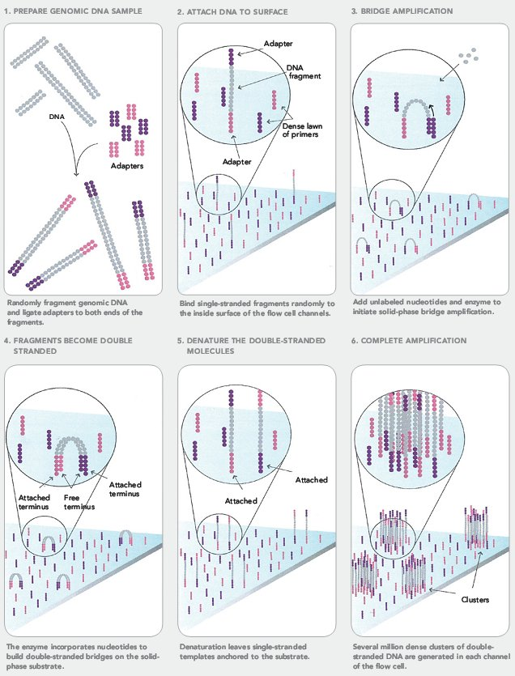
Next Generation Sequencing (NGS)
https://sites.google.com/site/himbcorelab/illumina_sequencing

Slide 9
Next Generation Sequencing (NGS)
https://sites.google.com/site/himbcorelab/illumina_sequencing

Slide 10
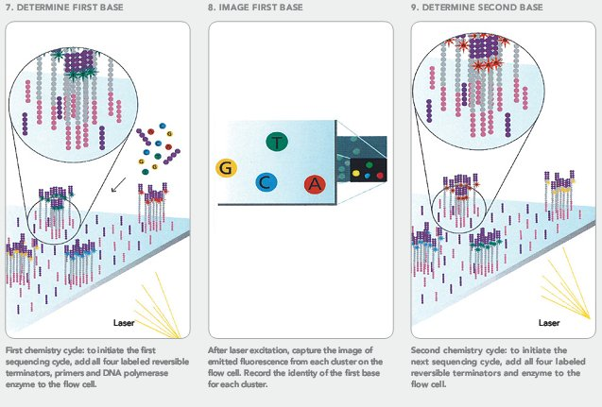
Next Generation Sequencing (NGS)
https://sites.google.com/site/himbcorelab/illumina_sequencing

Slide 11

Next Generation Sequencing (NGS)
https://sites.google.com/site/himbcorelab/illumina_sequencing

Slide 12
Next Generation Sequencing (NGS)
This Illumina Video is helpful for visualization!

Slide 13
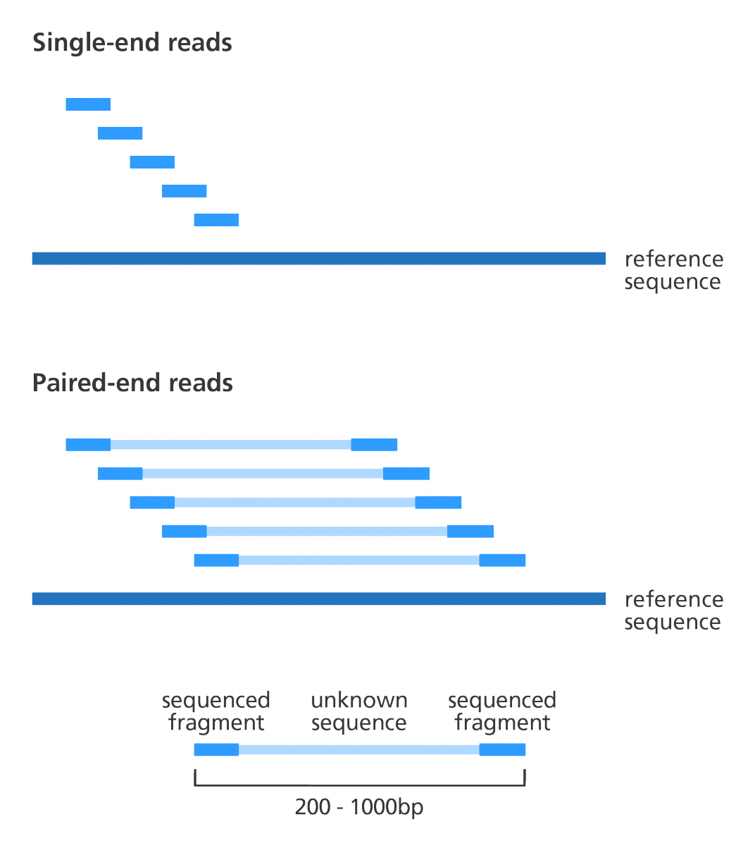
Paired end vs Single end reads
In single-end reads, only one end of the fragment is sequenced.
In paired-end reads, both ends of the fragment are sequenced.
“Insert Size”
https://www.biostars.org/p/267167/

Slide 14
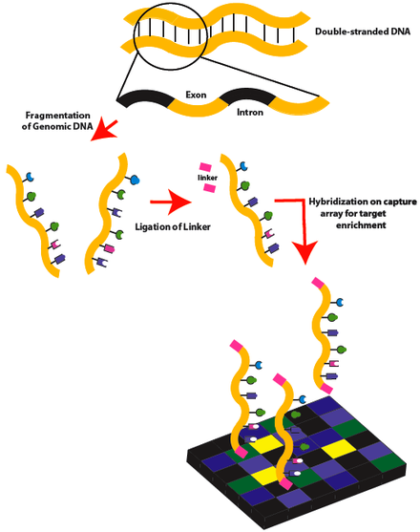
Exome Sequencing
Whole Exome Sequencing (WES) aims to sequence all protein-coding regions of genes in a genome, called exons
Exons comprise ~1% of the human genome and cause 80% of characterized inherited disordered
Array-based capture is an extra step in library preparation that enriches for exons.
Sequences that are complementary to the exons are used as probes to capture exonic DNA fragments, uncacptured fragments are washed away.
https://en.wikipedia.org/wiki/Exome_sequencing

Slide 15

The result: lots of short reads
How do we make sense of these?
Today: we’ll align to a reference sequence and look for variants

Slide 16
Variant Calling workflow
Quality Control
Align reads to a reference
Alignment cleanup
Variant Calling
Variant Annotation and Interpretation
https://github.com/hbctraining/In-depth-NGS-Data-Analysis-Course

Slide 17
Overview
A reference sequence is a previously determined sequence from your organism
Reads are aligned to the reference based on sequence similarity
Variants are positions where your sequences differ from the reference

Slide 18
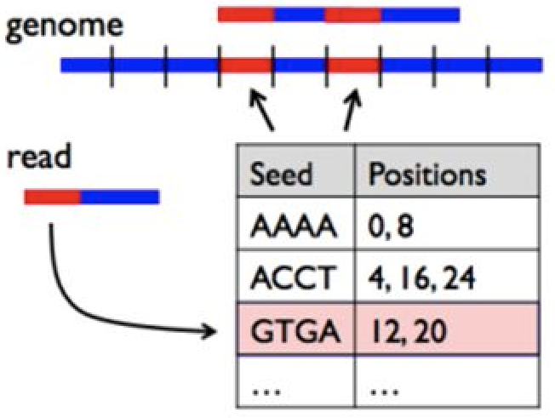
Alignment
The goal of read alignment is to find the correct location in a reference genome from which the short read originated
Insertions, deletions, and mismatches are allowed
There may be >1 equally good choices
Comparing millions of reads to billions of reference positions (human genome) is very time consuming
For a single read of length m and a genome of length n : O(mxn) comparisons

Slide 19
Alignment
Creating an index of our reference sequence speeds things up
An index is a lookup table, where for each short sequence in the reference genome (seed), a list of all positions in the reference genome where that sequence is found.
The index is created only once for a given genome
For read alignment: look up the positions for the first 4 bases (seed) of my read in my index table
For a single read of length m and a genome of length n : O(mxlog2(n))

Slide 20
Variant Calling
Our variant caller provides a list of positions where the sequenced base is different from the reference base
Quality metrics are also provided to help us judge whether the variant is a technical artifact
Reference position 13,635,567
G -> A
6/6 reads -> High confidence
Reference position 13,630,586
G -> A
1/8 reads -> Low confidence

Slide 21
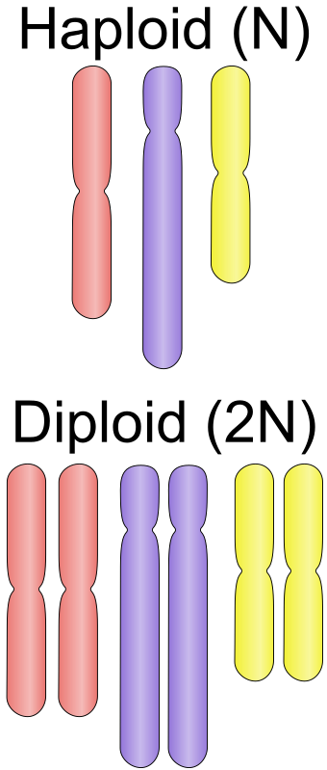
Ploidy and Variant Calling
Ploidy is the number of copies of each chromosomes
Humans cells are diploid for autosomal chromosome and haploid for sex chromosomes
Bacteria are haploid
Viruses and Yeast can by haploid or diploid
https://en.wikipedia.org/wiki/Ploidy

Slide 22
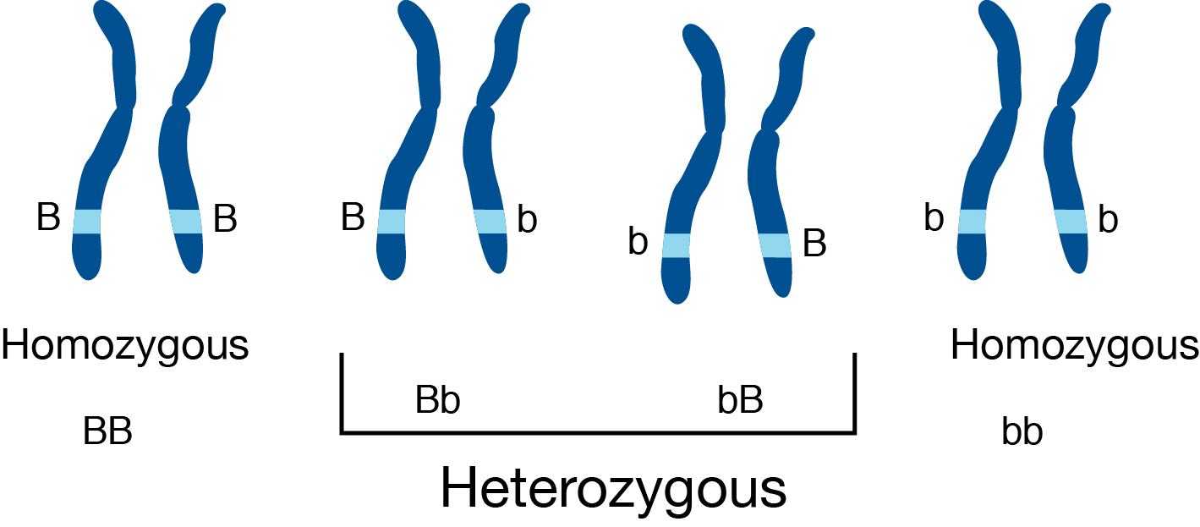
Ploidy and Variant Calling
Variant callers can use ploidy to improve specificity (avoid false positives) because there are expected variant frequencies, e.g. for diploid:
Homozygous
both copies contain variant
fraction of the reads ~1
Heterozygous –
one copy of variant
fraction of reads with variant ~0.5
https://en.wikipedia.org/wiki/Ploidy

Slide 23
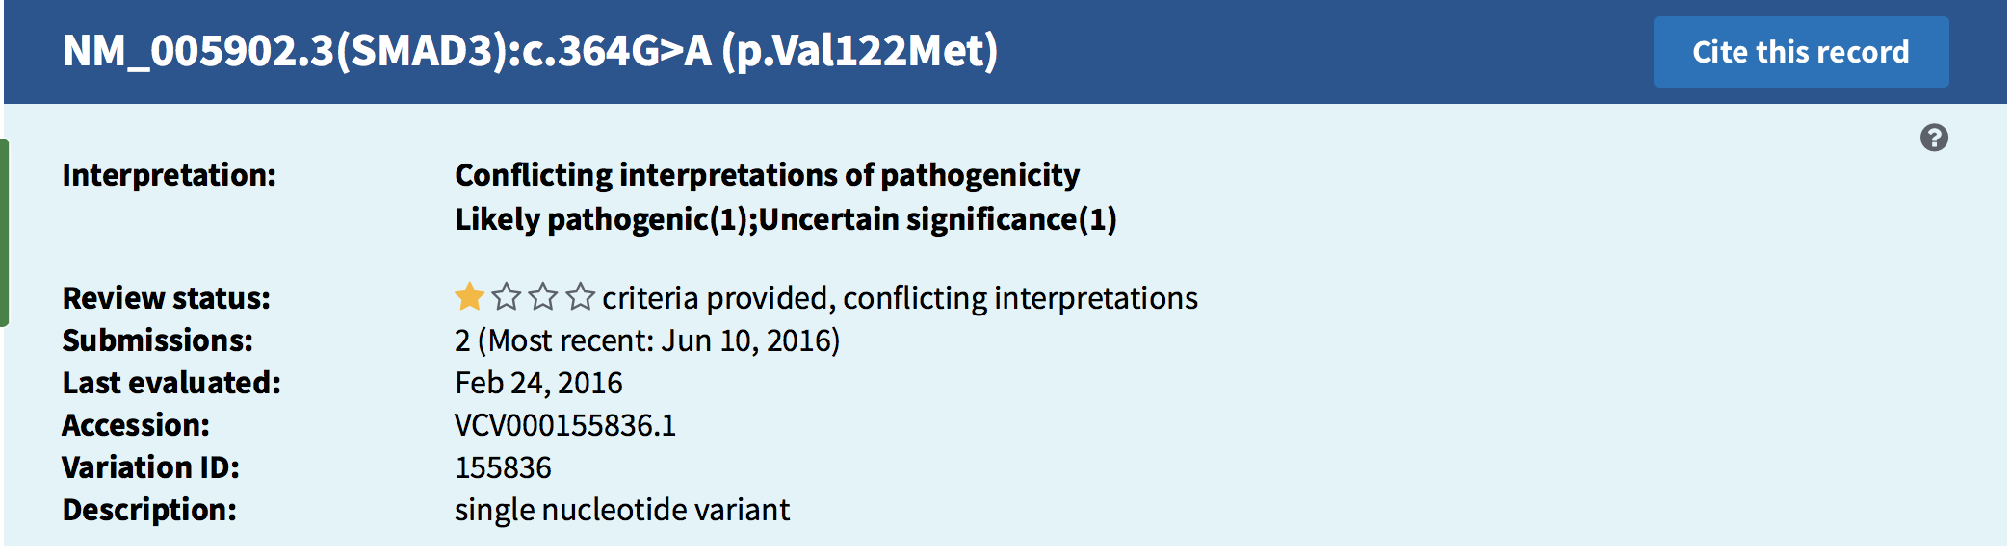
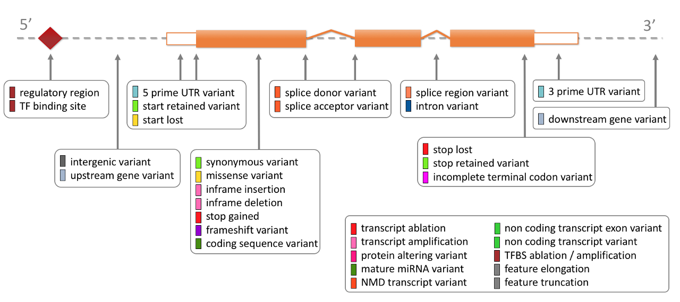
Interpretation
ClinVar: Database of variants in relation to human health
Position 13,635,567
G -> A
6/6 reads -> High confidence
Variant Effect Predictor (VEP) : what is the predicted consequence of the variant in a gene transcript?

Slide 24
Data for this class
GIAB was initiated in 2011 by the National Institute of Standards and Technology "to develop the technical infrastructure (reference standards, reference methods, and reference data) to enable translation of whole human genome sequencing to clinical practice" [1]
The source DNA, known as NA12878, was taken from a single person: the daughter in a father-mother-child 'trio' (she is also mother to 11 children of her own) [4]. Father-mother-child 'trios' are often sequenced to utilize genetic links between family members.
https://github.com/hbctraining/In-depth-NGS-Data-Analysis-Course/blob/master/sessionVI/lessons/01_alignment.md

Slide 25
For this class, I’ve created a small dataset
Sample: NA12878
Gene: Cyp2c19 on chromosome 10
Sequencing: Illumina, Paired End, Exome

Slide 26
Variant Calling workflow
Quality Control
Align reads to a reference
Alignment cleanup
Variant Calling
Variant Annotation and Interpretation
https://github.com/hbctraining/In-depth-NGS-Data-Analysis-Course

Slide 27
Thank you
Especially to:
Wenwen Huo, postdoctoral research scholar Isberg Lab, Tufts Medical School
Shawn Doughty, Research Computing Manager, TTS
Delilah Maloney, High Performance Computing Specialist, TTS
Susi Remondi, Senior Technical Training Specialist, TTS
For more tutorials like these on doing Bioinformatics on the Tufts HPC cluster:
https://sites.tufts.edu/biotools/tutorials/
For more great bioinformatics tutorials:
https://github.com/hbctraining/
For questions on Bioinformatics or the Tufts HPC, contact tts-research@tufts.edu

